Slide 1
Unit V Macros

Slide 2
Table of content
Understanding Excel Macros
Activating the Developer Tab in Excel
Creating a Macro with the Macro Recorder
Editing a Macro with VBA
Creating Buttons to Run Macros

Slide 3
1. Understanding Excel Macros
A macro is an action or a set of actions that you can run as many times as you want.
When you create a macro, you are recording your mouse clicks and keystrokes.
After you create a macro, you can edit it to make minor changes to the way it works.

Slide 4
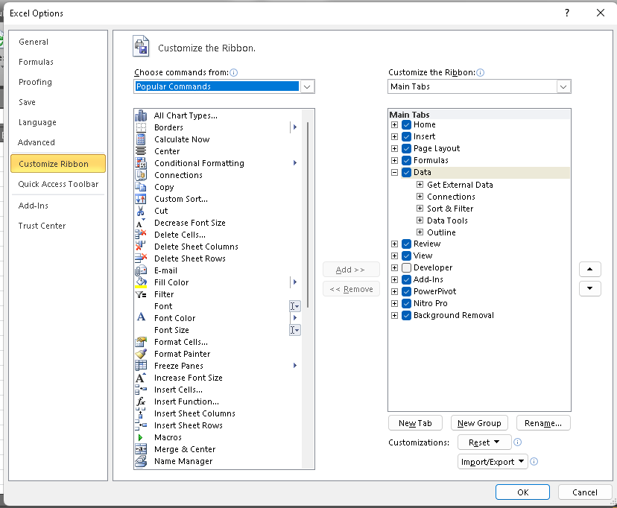
2. Activating the Developer Tab in Excel

Slide 5
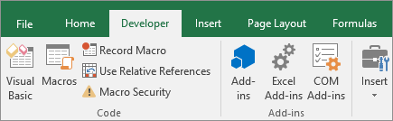


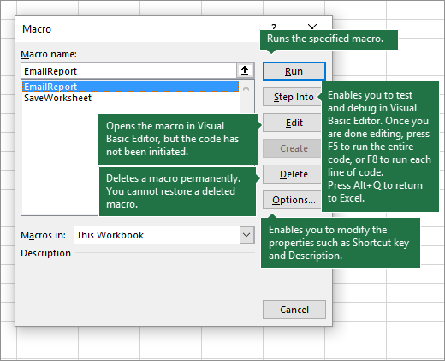
3. Creating a Macro with the Macro Recorder

Slide 6
To-do macro task
Eg: Format similar data using the macro

Slide 7
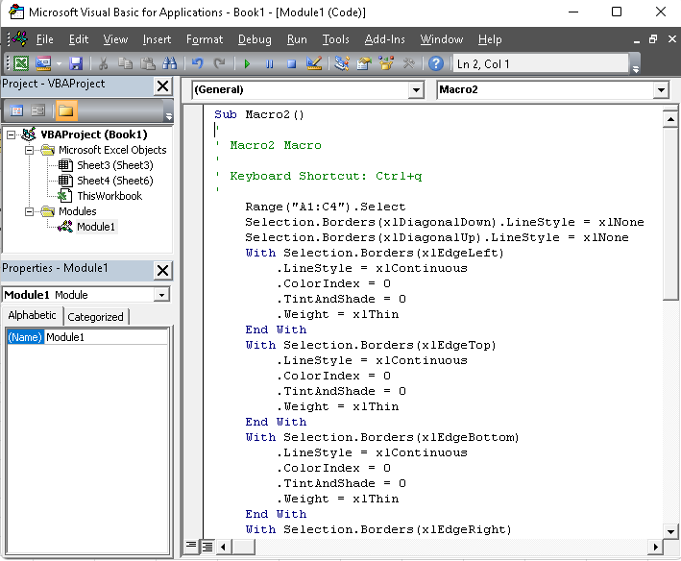
4. Editing a Macro with VBA

Slide 8
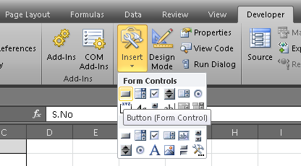
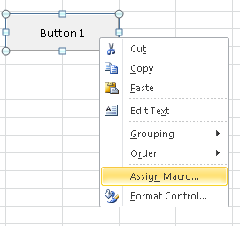
5. Creating Buttons to Run Macros

